Slide 1
COVID-19 Statistics
01-08-2020

Slide 2
Latest Statistics
(updated 01-08-2020)
Total confirmed cases worldwide: 17,849,122
257,875 new cases (1% increase)
Total fatal cases worldwide: 685,039
5,615 new fatalities (0% increase)
Israel recorded 72,218 cases in total
increased by 1,248 cases (1% increase)
34.0# in confirmed cases, 56.0# in mortality
19.0# in cases per capita, 55.0# in mortality rate

Slide 3
Latest Statistics
(updated 01-08-2020)
Worldwide mortality rate: 3.8% (-0.0%)
Israel mortality rate: 0.7% (+0.0%)
US has most cases in total (4,620,444)
US has most fatal cases in total (US)
US recorded the most new cases (58,406)
US recorded the most new fatal cases (1,133)

Slide 4
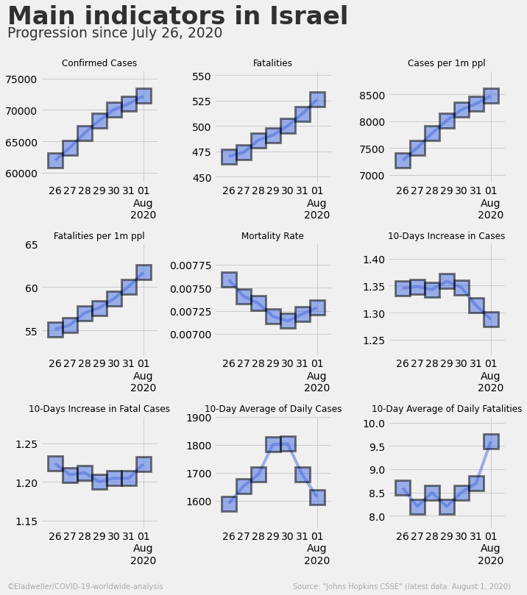

Slide 5
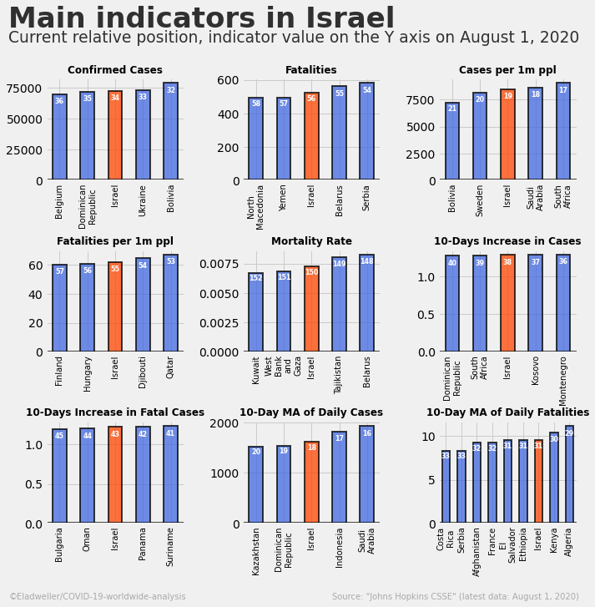

Slide 6
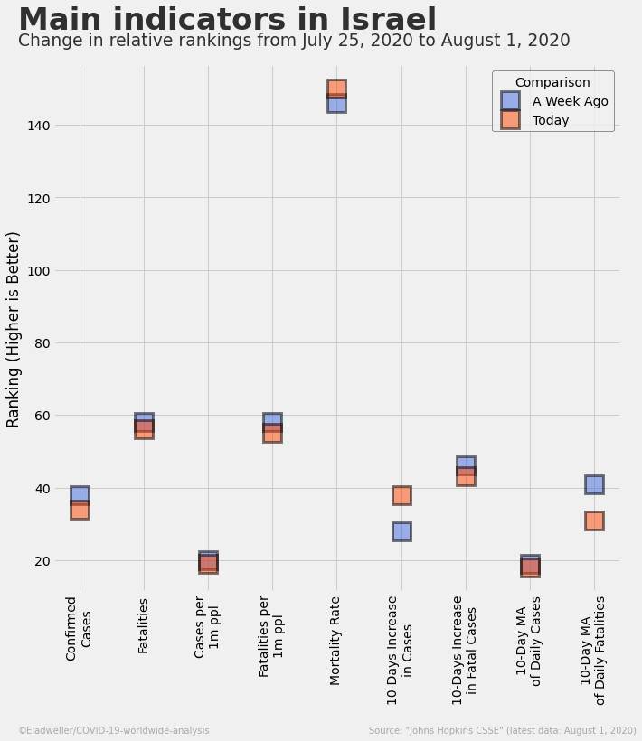

Slide 7
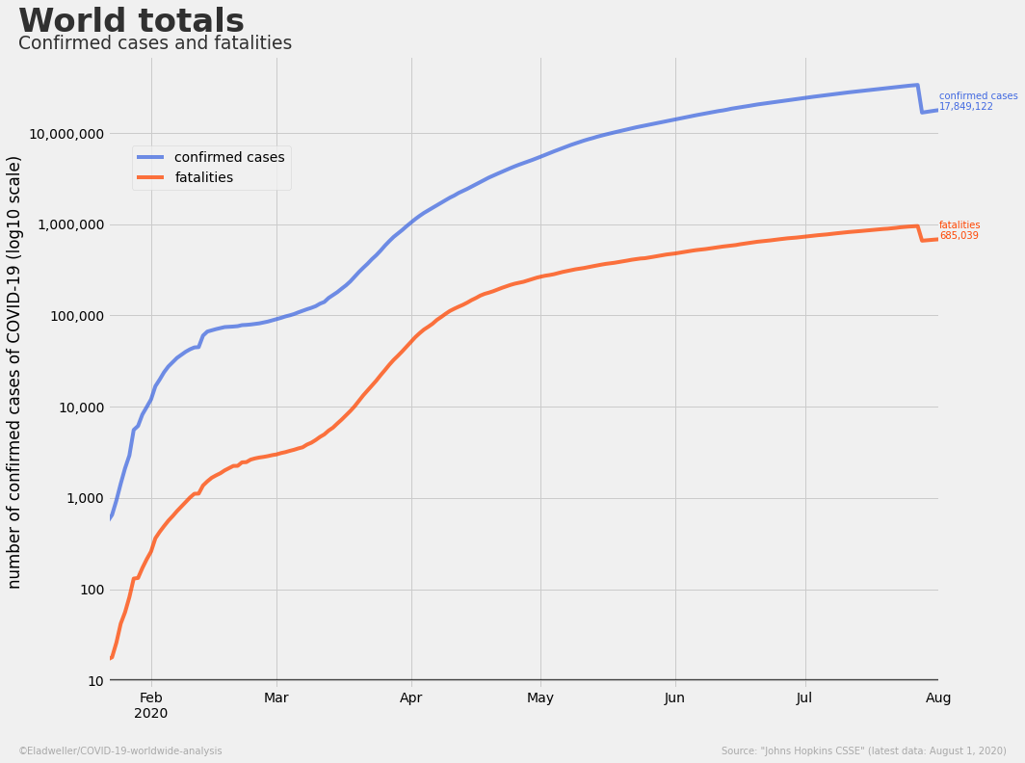

Slide 8
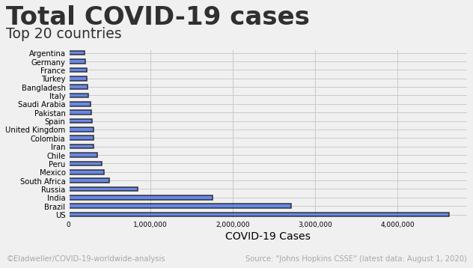

Slide 9
